Slide 1
Lecture 3. Copying Objects; I/O and Serialisation; JSON and GSON

Slide 2
Part I
Copying Objects; shallow vs deep cloning

Slide 3
Aliasing: Copying References
Assignment of an object reference to a variable creates an alias: the variable refers to an existing object
Exercise:
Employee employee1 = new Employee("Pete");
Employee employee2 = employee1;
employee1.setSalary("5000");
employee2.setSalary("7000");
Passing an object to a method means passing a reference
It does not make a copy of the object!
Copying references is much faster and requires less memory compared to copying the actual object with its various fields
But sometimes you may want to make a copy of an object
Notes:
See this code example in IntelliJ to demonstrate that employee1 and employee2 are *exactly* the same object!

Slide 4
Cloning in Java
Class Object:
protected Object clone()
Method creates and returns a shallow copy of an object
Same class as the original
Primitive type fields: values are copied
Non-primitive type fields: aliasing, e.g. copying of the reference only
If you want to invoke Object.clone() on an object, then the class of that object should implement the interface Cloneable
If it does not, then Object.clone() will throw a CloneNotSupportedException

Slide 5
More Considerations
If you want to copy objects of a class, then you should usually write a custom method for that
It is normally expected that
The cloned object is equal to the original object (e.g. x.clone().equals(x))
The cloned object is of the same type as the original object (e.g. x.clone().getClass() == x.getClass())
There is no need to clone immutable objects – you can just copy references to such objects
Notes:
An immutable object is an object whose internal state remains constant after it has been entirely created.

Slide 6
Java Example (slide 1)
public class Author {
public String id;
public String name;
public Author(String authorId, String name) {
this.id = authorId;
this.name = name;
}
…
}

Slide 7
public class Book implements Cloneable {
public String isbn;
public double price;
public String title;
public List<Author> authors;
public Book(String title, String isbn, double price, List<Author> authors) {
this.title = title;
this.isbn = isbn == null ? "" : isbn;
this.price = price;
this.authors = new ArrayList<>();
if (authors != null)
this.authors.addAll(authors);
}
…
}

Slide 8
‘Shallow’ Book Cloning
public Book clone() {
try {
return (Book) super.clone();
} catch (CloneNotSupportedException e) {
e.printStackTrace(); return null;
}
}
In the clone, the fields isbn, title and authors refer to the same objects as the original
This is not a problem for isbn and title because strings are immutable in Java
But it means that the mutable authors list will be shared by the original Book object and the clone
They are not independent objects!
Notes:
Show this example in IntelliJ

Slide 9
‘Shallow’ Book Cloning
Original
Clone
isbn
price=22.00
title
authors
"978-0007120765"
isbn
price=22.00
title
authors
"The Mystery of the Blue Train"
List<Author>
id
name
"AGAT"
"Christie, Agatha"

Slide 10
‘Deep’ Cloning
public Book clone() {
return new Book( this.title, this.isbn, this.price, this.authors);
}
Changes to this clone will not affect the original object and vice versa
Note that the Book constructor creates a new ArrayList object and assigns it to the authors field
Notes:
How to create an immutable class?
1. The class must be declared as final (So that child classes can’t be created)
2. Data members in the class must be declared as final (So that we can’t change the value of it after object creation)
3. A parameterized constructor
4. Getter method for all the variables in it
5. No setters(To not have the option to change the value of the instance variable)
Note the last bullet point in the slides! Book constructor creates a NEW arraylist every time! So that’s why it’s ok to simply return new instances of Book(). Otherwise we’d have to copy all a

Slide 11
‘Deep’ Book Cloning
Original
Clone
isbn
price=22.00
title
authors
"978-0007120765"
isbn
price=22.00
title
authors
"The Mystery of the Blue Train"
List<Author>
List<Author>
id
name
"AGAT"
"Christie, Agatha"
Notes:
Because the clone uses a new Book constructor, which creates a new Arraylist, we end up with 2 completely different copies of the same list. They both have the same values, but as they are separate objects, any updates won’t affect each other. This is because both id and name are Strings, such IMMUTABLE.

Slide 12
Dealing with non-immutable objects
Assume that you wanted to clone the List authors on its own
How do we deep clone it?
We’d have to create a new instance and copy all of its elements
We’ll see such an example it the lab

Slide 13
Weaknesses of Cloning
Weaknesses of the unified cloning mechanism:
The compiler cannot guarantee that your implementation satisfies the expected conditions
There is nothing that indicates how deep your cloning is (you won’t know if it’s deep or shallow clone)
This doesn’t stop you from providing cloning functionality in other forms such as constructors or functions with self-explanatory names
An alternative is to create a user-defined copy() method, rather than call clone(), as it might be hard to implement it correctly and it might lead to errors
And then just create new instances of any classes that should be copied and copy all of their elements
In this way you do not need to implement the Cloneable interface and handle CloneNotSupportedException

Slide 14
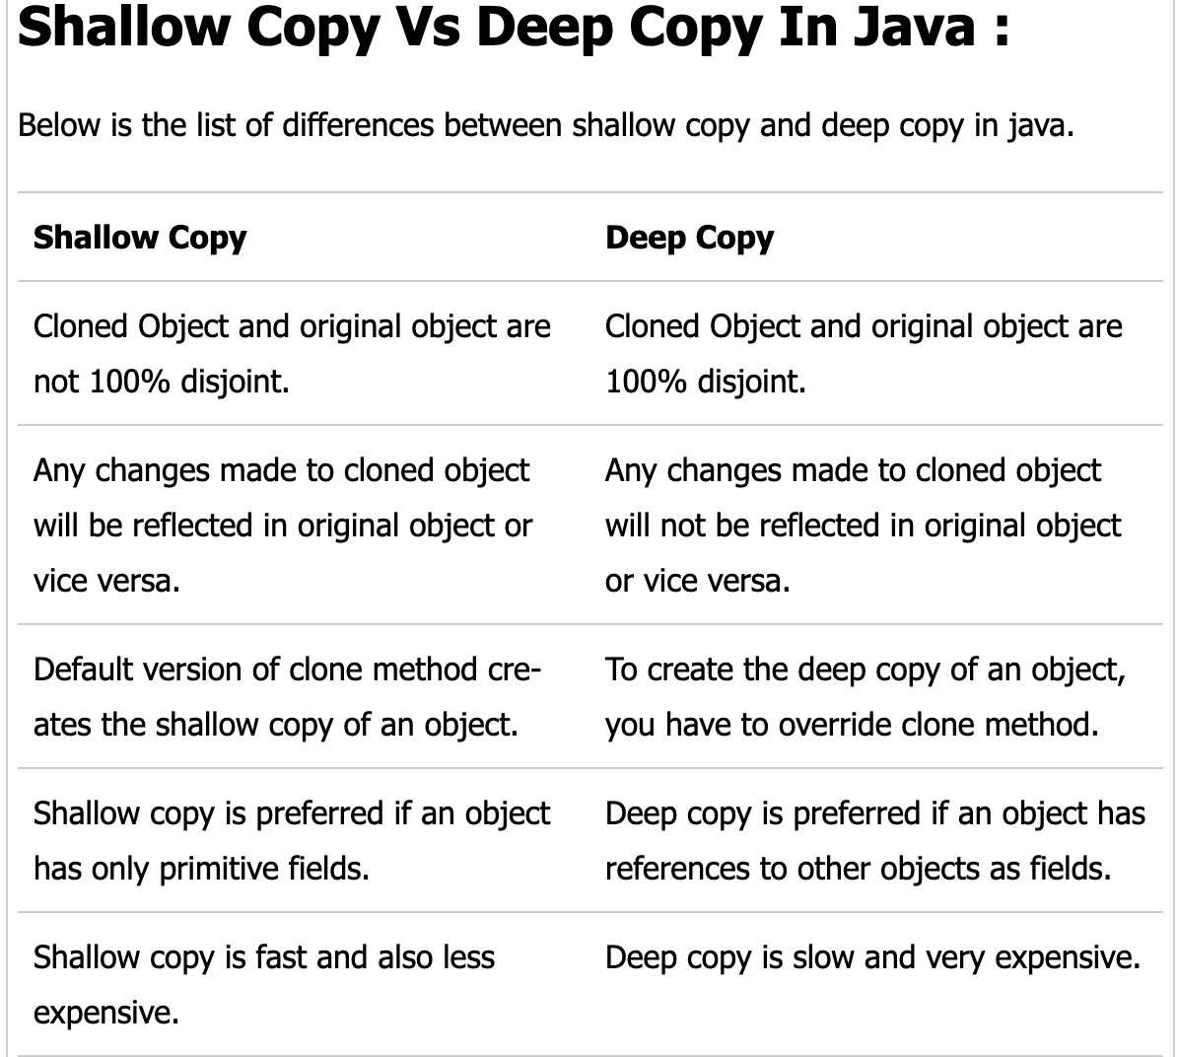
Notes:
From: https://javaconceptoftheday.com/difference-between-shallow-copy-vs-deep-copy-in-java/

Slide 15
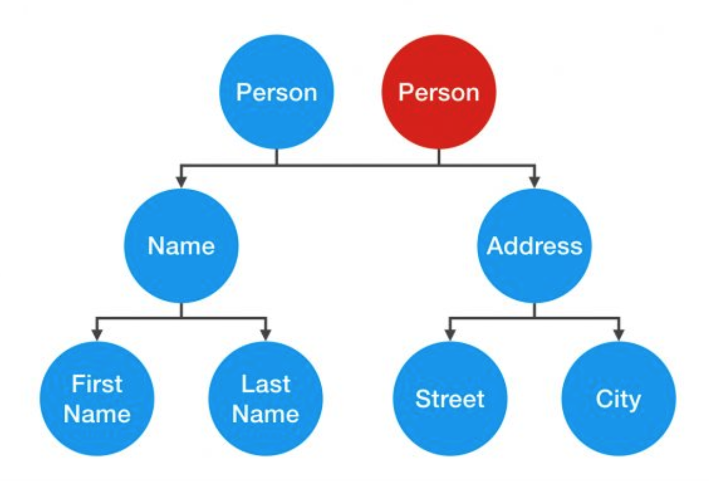
Shallow cloning
https://dzone.com/articles/java-copy-shallow-vs-deep-in-which-you-will-swim

Slide 16
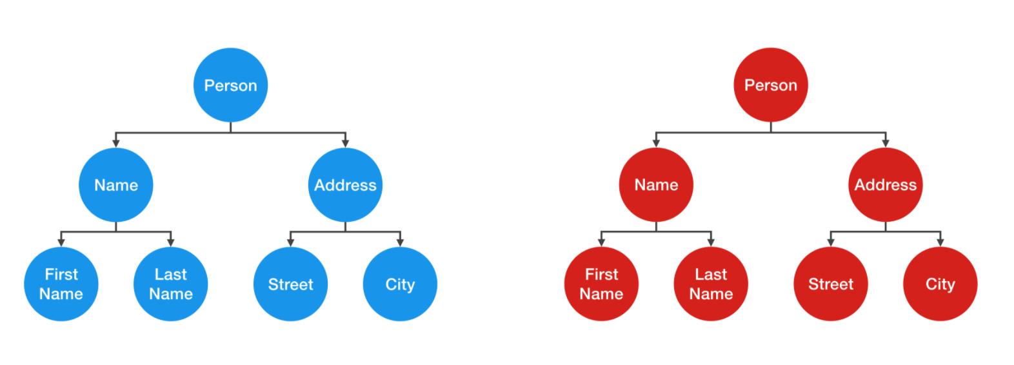
Deep cloning
https://dzone.com/articles/java-copy-shallow-vs-deep-in-which-you-will-swim

Slide 17
Part II
Input/Output Streams
Notes:
This section is a refresher

Slide 18
I/O Streams
Java has APIs for stream-based I/O
Input: reading from a source
Output: writing data to a destinations
Streams can be connected to many different kinds of sources and destinations including console, local files, remote files, sockets, devices, memory arrays, …
Data communicated in streams can be
low level (bytes) or
more high level (character streams, object streams)
Notes:
Streams are often buffered so as to improve performance
But for output streams, this means you may have to explicitly flush the buffer on occasions
A Buffer is a portion in the memory that is used to store a stream of data from peripheral devices. Then from this buffer this stream of data is collected and stored in variables. A stream can be defined as a continuous flow of data. The buffer is quite useful as Java deals everything as a String.

Slide 19
Streams in Java
Java provides classes InputStream and OutputStream for reading from and writing to binary streams
Examples of streams:
System.in, System.out, System.err
FileReader, FileWriter
For textual data, one can use wrappers:
InputStreamReader can be used as a wrapper for InputStream
OutputStreamWriter can be used as a wrapper for OutputStream
Commonly used with BufferedReader / BufferedWriter for buffering the data and hence improving the efficiency

Slide 20
Part III
Serialisation and deserialisation

Slide 21
Serialisation
Serialisation is the process of saving Java objects into a stream
Java example: objects are automatically serialised when you write them into an ObjectOutputStream:
ObjectOutputStream out = new ObjectOutputStream( new FileOutputStream("bank.dat")); out.writeObject(b);
Objects can be composed from other objects
includes reading/writing of all instance fields, and all instance fields of those fields, etc.
A single writeObject() invocation can lead to a large number of objects being written!

Slide 22
De-Serialisation
ObjectInputStream is for reading objects from a stream
readObject() returns an Object reference
You need to know the types of the objects to cast them
ObjectInputStream in =
new ObjectInputStream(
new FileInputStream("bank.dat"));
BankAccount b = (BankAccount) in.readObject();
readObject() can throw ClassNotFoundException and IOException
these are checked exceptions, so you must either catch or declare them

Slide 23
(De)Serialising a Book Object
public static void main(String[] args) throws IOException, ClassNotFoundException { Author kenGrahame = new Author("GRAH", "Grahame, Ken"); Book willows = new Book("The Wind in the Willows",
"0140621229", 1406, kenGrahame); try (ObjectOutputStream out = new ObjectOutputStream(
new FileOutputStream("book.dat"))) { out.writeObject(willows); } try (ObjectInputStream in = new ObjectInputStream(
new FileInputStream("book.dat"))) { Book willowsLoaded = (Book) in.readObject(); if (willowsLoaded.equals(willows)) System.out.println("(De)Serialization successful"); } }

Slide 24
Serialisation API
Enabled by implementing interface Serializable
Many standard classes implement this interface
When defining a new class, you can declare fields as transient – these will not be serialised
Default implementation of Serializable interface:
all non-transient fields must be serialisable
if the parent class it not serialisable, then it must have an accessible no-arg constructor to initialise the state

Slide 25
Workings of Serialisation
Writing objects to an ObjectOutputStream
each object is assigned a serial number in the stream
if the same object is saved twice, only the serial number is written out the second time
writes whole object
transient and static (“class”) fields are ignored
if a non-transient instance field cannot be serialised (e.g. Sockets cannot be serialised), the process will fail with a NotSerializableException
Objects are saved in a binary format
including class name and serialVersionUID

Slide 26
Workings of De-Serialization
JVM reads object and determines its class
JVM attempts to find and load object class
Creates a new object
object instance variables are given values
transient fields get a null value for reference (non-primitive) types and defaults (0, false, …) for primitive types
Objects are read from a stream in the same order in which they were written
Notes:
Duplicate serial numbers are restored as references to the same object

Slide 27
Serialization: The Version Problem
Problem with different versions of a class
suppose attributes are added, deleted, or modified?
how to read in previously saved objects in this case?
Serious problem for long-term persistence!
De-serialisation algorithm can deal with some changes:
adding new instance variables, changing instance variable access level, change of inheritance tree
typically get null/default values for new fields
If you want the JVM to de-serialise objects belonging to an older version of a class, set serialVersionUID for the class
Otherwise this identifier will be computed automatically, so it will change whenever the class is changed
The JVM will try de-serialisation of an object if the UID of the serialised and the current class are the same
Notes:
UID Unique Identifier
For more info, see: https://www.javaworld.com/article/2071731/ensure-proper-version-control-for-serialized-objects.html?page=2

Slide 28
Further considerations
Very easy to store / load objects
Can be used for deep cloning, although that tends to be slower than field-by-field cloning
Major scalability problems, as it reads / writes large objects in one go
difficult to pick out particular parts
infeasible for very large objects
Potential version problems if the Java class has changed since the object was stored
Potential problems with serialising objects from third-party libraries if they were not tagged as serializable

Slide 29
PART IV
JSON and GSON

Slide 30
JSON Data-Interchange Format
Java serialisation only works between Java programs
How to exchange data more generally?
JSON is a text format that can represent objects
Human-readable and editable (within limits)
Derived from “JavaScript Object Notation”
Supported in many different programming languages with libraries for (de-)serialisation, parsers, etc.
Popular for web applications and for web-services

Slide 31
JSON Format
Primitive values: strings, numbers, booleans, or null:
"abc", 123, true, false, null
Two data structures: objects and arrays
An object (“record”, “dictionary”, “map”, …) is an unordered collection of name/value pairs
{"field1": value1, "field2": value2, …}
Do not forget the quotes around the field names
An array is an ordered collection of values:
[value1, value2, …]
JSON objects are just data
No inbuilt “unique identifier” such as the JVM address

Slide 32
Support of JSON in Java
Limited support by standard Java libraries
One of the best libraries is Gson

Slide 33
Gson
Open source library to convert Java objects to JSON and back
Created by Google developers, distributed as a jar-file
Does not require annotation of classes
Supports generics and nested classes
Ignores static and transient fields by default

Slide 34
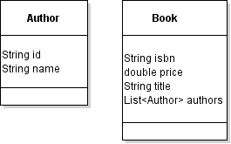
Sample Classes: Book and Author

Slide 35
Gson: Basic Usage
Gson gson = new Gson();
Author author = new Author("01", "Joyce, James");
// serialisation
String authorJson = gson.toJson(author);
System.out.println("Json: " + authorJson);
// round trip: de-serialisation of serialised object
Author authorCopy = gson.fromJson(authorJson, Author.class);
System.out.println("Round trip: " + authorCopy);
Program output
Json: {"id":"01","name":"Joyce, James"}
Round trip: Author[01, Joyce, James]

Slide 36
Example: A List of Books serialised to JSON
[ { "isbn": "0-13-110362-8",
"price": 42.0,
"title": "The C Programming Language",
"authors": [ { "id": "KERN", "name": "Kernighan, Brian" },
{ "id": "RITC", "name": "Ritchie, Dennis" } ]
},
{ "isbn": "0-201-83595-9",
"price": 29.95,
"title": "The Mythical Man-Month",
"authors": [ { "id": "BROO", "name": "Brooks, Frederick P." } ]
}, …
]
Notes:
Array of objects

Slide 37
public class BooksJson {
public static final String BOOKS_JSON_FILE = "data/books.json";
public static final String BOOKS_JSON_COPY_FILE =
"data/books_copy.json";
public static final Gson GSON = new GsonBuilder() .setPrettyPrinting().disableHtmlEscaping().create();
public static void writeBooks(List<Book> books, String fileName) throws IOException {
Path path = Paths.get(fileName);
BufferedWriter writer = Files.newBufferedWriter(path);
GSON.toJson(books, writer);
writer.close();
}

Slide 38
...
public static List<Book> readBooks(String fileName) throws IOException {
Path path = Paths.get(fileName);
BufferedReader reader = Files.newBufferedReader(path);
Type t = new TypeToken<List<Book>>(){}.getType();
List<Book>result = GSON.fromJson(reader, t);
reader.close();
return result;
}
public static void main(String[] args) throws IOException {
List<Book> books = BooksJson.readBooks(BOOKS_JSON_FILE);
for (Book book : books)
System.out.println(book);
BooksJson.writeBooks(books, BOOKS_JSON_COPY_FILE);
}
}

Slide 39
Comments about Book List Example
GsonBuilder for creating a configurated Gson instance
Gson can read / write from files via readers / writers
Don’t forget to close these when you are done with them!
setPrettyPrinting() configures Gson to output Json that fits in a page for pretty printing. This option only affects Json serialisation
disableHtmlEscapting. By default, Gson escapes HTML characters such as <>. Use this option to configure Gson to pass-through HTML characters as is
Use of Type and TypeToken for deserialisation of generics
This is necessary because the Java compiler erases information about type parameters in generics – we will discuss this further later on in this module
Notes:
Prettyprint is the application of various stylistic formatting conventions to text files, such as source code. As a result, the serialization of the object is saved in an easy-to-read “code” format.

Slide 40
Concluding Remarks about Gson
Gson serialises whole “object trees” similar to Java's serialisation, but it does not include JVM addresses nor types
It parses numbers by default as Double values; this can occasionally cause problems when you try to de-serialise generic types instantiated with integer type parameters
Both serialisation and de-serialisation can be customised
In particular you can exclude certain fields
You can even code custom (de)serialisation for a class
Please see the online user guide for more details
There are several other JSON libraries for Java
Notably Jackson and javax.json

